Slide 1


Facial Emotion Detection
Critical Thinking Course

Slide 2

Learnings
Building Process
01
03
Improve Training
USE CASES
02
04
Here you could describe the topic of the section
Here you could describe the topic of the section
Here you could describe the topic of the section
Here you could describe the topic of the section

Slide 3
Use Cases - Gaming Industry
Facial expression recognition can also be used in the video game testing phase.
A focused group of users are asked to play a game for a given amount of time and their behavior and emotions are monitored.
By using facial expression recognition, game developers can gain insights and draw conclusions about the emotions experienced during game play and incorporate that feedback in the making of the final product.

Slide 4
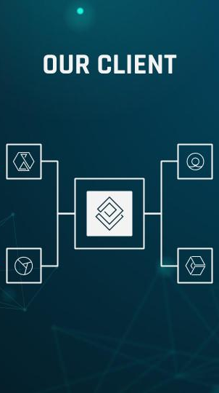
Use Cases - Behavioural Testing
Suppose you have built some product and want to understand the genuine feedback of your customer on it, then you can incorporate facial expression recognition on your product which keeps tracking customer’s emotions.
It makes it easy to capture a few expressions like sadness , happiness or surprise while they walk through your product.

Slide 5
Use Cases - Market Research
Traditionally market research was done by conducting surveys to find out what consumers want and need, the methods involved employing people to observe reactions of customers while interacting with a brand or a product.
Facial expression recognition can save the day by allowing companies to conduct market research and measure moment-by-moment facial expressions automatically, making it easy to aggregate the results.

Slide 6
Learnings
ONE
TWO
THREE
Learned how to build convolutional neural networks on Colab and reuse the trained objects in our local machine to perform real time predictions.
Got introduced to Open CV and Dlib.
Learned about Google Colab and GPUs and How we can utilize these Resources for solving High level Computational Problems where Datasets consist of Images, Text, and Videos.

Slide 7
Learnings
FOUR
FIVE
SIX
Created a Model that can detect different expressions in a face given their images.
Performed data augmentation on our images to make our model more robust.
Also performed two phase training on our models, where we have frozen a few layers before our model starts overfitting.

Slide 8
Learnings
SEVEN
evaluated our model on Test set and applied real time prediction..

Slide 9

Various Approaches to Improve Training
Performing face detection and cropping face images in our training dataset.
Although we have closely cropped faces in our dataset, they are very noisy.
By filtering out all images which were not detected by face detection algorithm we can make our model more robust.

Slide 10
Various Approaches to Improve Training
Increase Number of phases and Decrease number of epochs per phase while training.
For example:
You can train a model using a phase 1 with 6 epochs repeated by phase 2 with 4 epochs for 2 times.

Slide 11
Various Approaches to Improve Training
Try out a better version of EfficientNet.
There are even better versions of EfficientNet such as B3 to B7.
We have used EfficientNetB2 just to keep it less computationally intensive.
So that it can be executed even on Low hardware specification.

Slide 12
Prerequisites
01 | 02 | 03 | 04
Good Knowledge of Python programming language, as the whole code would be written in python. | In depth knowledge over Linear and Logistic regression because these are the Bricks of Neural Networks. | Understanding of Basic Image processing. | Basic Understanding on Artificial neural networks and Convolutional neural networks Working and Implementation.

Slide 13
Understanding Problem Statement

Slide 14

Building Process
Dealing with Image data sets.
Performing Data Processing and Augmentation as and when required.
Creating and training a Convolutional Neural Network using Tensorflow 2.0

Slide 15
Facial Expression Recognition System
technology which uses biometric markers to detect emotions in human faces.
The six basic universal expressions: Happiness, Sadness, Anger, Surprise, Fear, and Disgust.

Slide 16
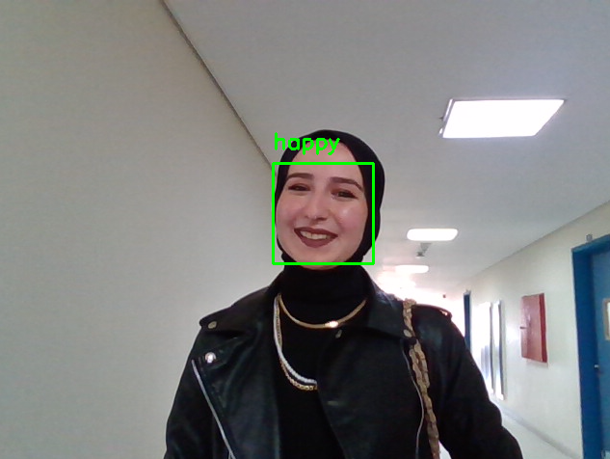
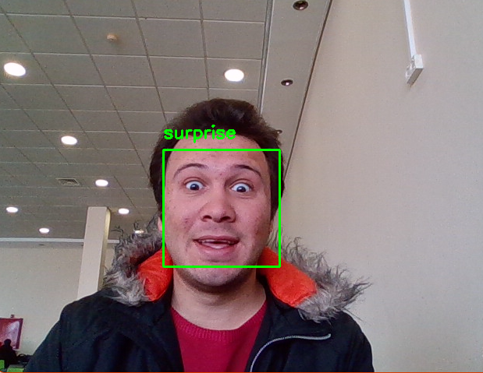
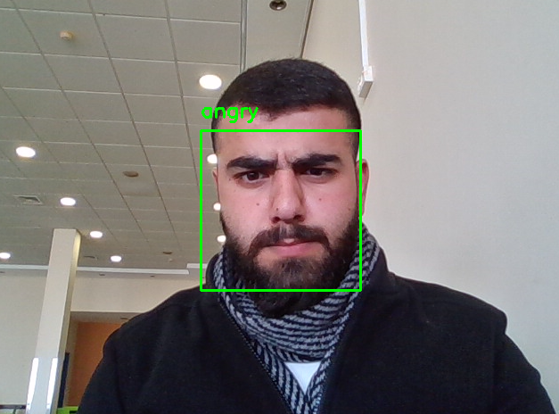
MEET THE TEAM
Hiba Habash
Ahmad Droobi
Ataa Shaqour

Slide 17
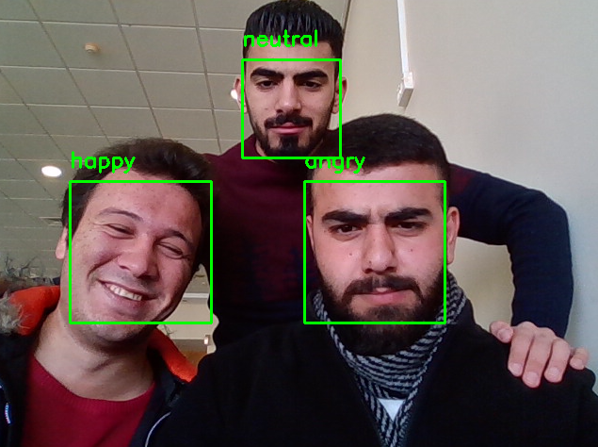
THANK YOU !

Slide 18
